Slide 1
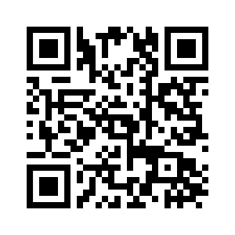
2025 Tandem Meetings February 12-15, 2025 | Honolulu
Multidisciplinary event highlighting the latest research and breakthroughs in the evolving field of HCT, cellular and gene therapy.
Sessions cover basic science, translational research and clinical studies.
Tracks include:
Administrative Director, APP, Nursing, Pharmacy & more.
Learn more and register now at tandemmeetings.com or scan the QR code.

